Slide 1

MULTIMODAL BIOMETRIC SYSTEM
PRESENTED BY :
ALISHA ORAON(21EC65R04)
ARNAB BISWAS(21EC65R01)
RITWIK DAS(21EC65R02)

Slide 2
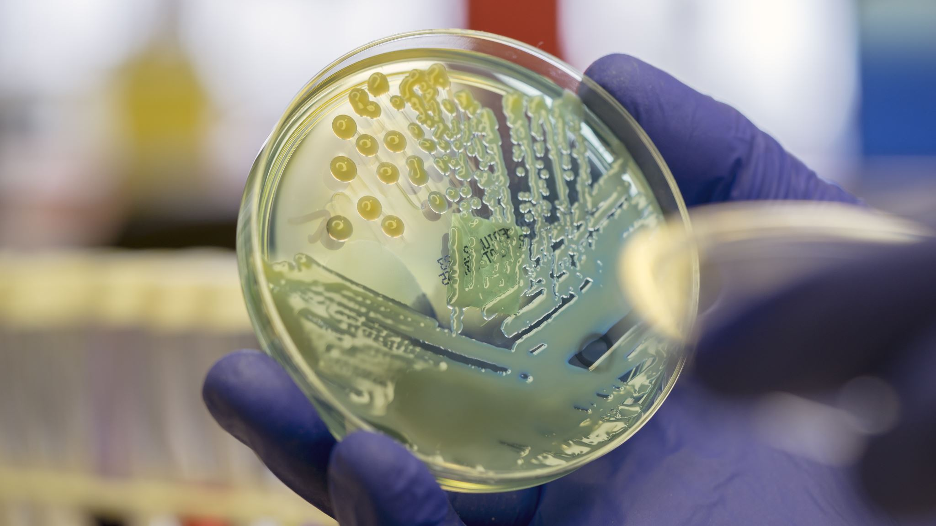
PREVIOUS WORK
A brief introduction to biometric system.
What is fingerprint recognition ?
Stages and processes involved in fingerprint recognition.
Introduction to face recognition
Processes involved in face recognition
Challenges in both fingerprint and face recognition
Solutions and furure work

Slide 3
INTRODUCTION
WHY MULTIMODAL BIOMETRIC SYSTEM ?
Overcomes the problem of unimodal biometric system such as noise, non-universality ,etc.
Enhances real time verification and reliability.
Enhances matching accuracy.
Fusion of face and fingerprint biometrics.
Matching score calculated after fusion with enhanced performance.

Slide 4

FINGERPRINT RECOGNITION
Acquisition stage
Pre-processing stage
Feature Extraction stage
Matching stage

Slide 5
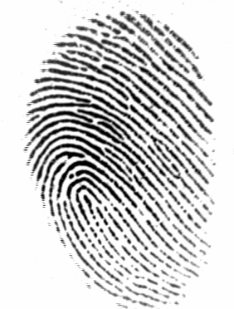

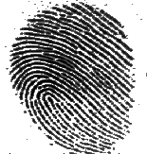
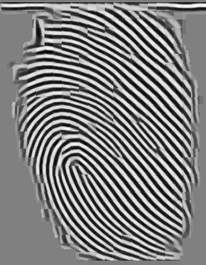
Pre-processing stage
Enhancement fingerprint image :
Normalization
Determine ridge orientations
Determine ridge frequency,
Apply filters Histogram Equalization
FFT Enhancement
(a)original image
( b)ridge segment
(c)Histogram
Equalization
(d) FFT Enhancement

Slide 6
FINGERPRINT IMAGE ENHANCEMENT
NORMALIZATION :
1) to get prescribed mean and variance.
2)to reduce variations in gray level values along ridges
ORIENTATION & FREQUENCY :
1)Defines invariant coordinates of ridges.
2)Gradient based orientation method is used.
3) Reliable ridge frequency from normalized input fingerprint.
FILTERS :
1) Gabos filters are used tuned to local ridge orientation and frequency.
2) Gabos filters as bandpass filters to remove the noise and preserve the true ridge structure.

Slide 7
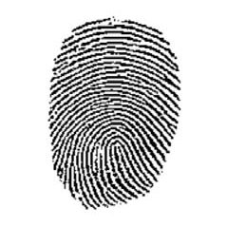
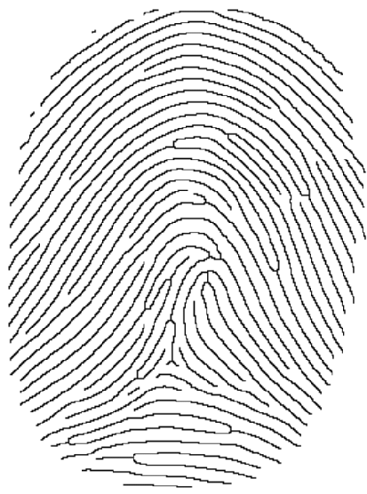
Pre-processing stage
Binarization
Adaptive Binarization Method is used
Thinning
also called as skeletonization
to reduce the ridges of fingerprint images
(a)Binary image
(b)Thinning image

Slide 8
Minutiae Algorithm
Input: the thinning of fingerprint image, the orientation image in radians and mask.
Output : Ridge ending, Ridge Bifurcation .
Find the size of thinning image.
Find the label connected components in 2-D binary image which get the total number of ridge and ridge map.
Scan the thinning fingerprint image to detect the minutiae , using crossing number algorithm.
Store the ridge endings and ridge Bifurcation

Slide 9
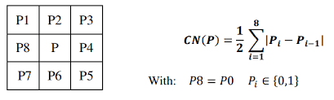
Minutiae Points Detection
Crossing Number (CN) concept :
Favored for its computational efficiency and inherent simplicity.
3*3 map moved across the whole image.
CN is defined as half the sum of the differences between pairs of adjacent pixels in the eight-neighborhood

Slide 10
Crossing Number Algorithm
CN | Properties
0 | Isolated Point
1 | End Point
2 | Connective Point
3 | Bifurcation
4 | Crossing Point
0 | 0 | 0
0 | 1 | 0
0 | 0 | 0
0 | 0 | 0
0 | 1 | 1
0 | 0 | 0
CN=0
CN=1
0 | 0 | 0
1 | 1 | 1
0 | 0 | 0
0 | 0 | 1
1 | 1 | 0
0 | 0 | 1
1 | 0 | 1
0 | 1 | 0
1 | 0 | 1
CN=2
CN=3
CN=4

Slide 11
False Minutiae Removal
Input : Minutiae Feature
Minutiae Extraction
Centralize the minutiae on window
Eliminate invalid and keep valid of minutiae
Output : Real minutiae
Keep real minutiae in vector

Slide 12
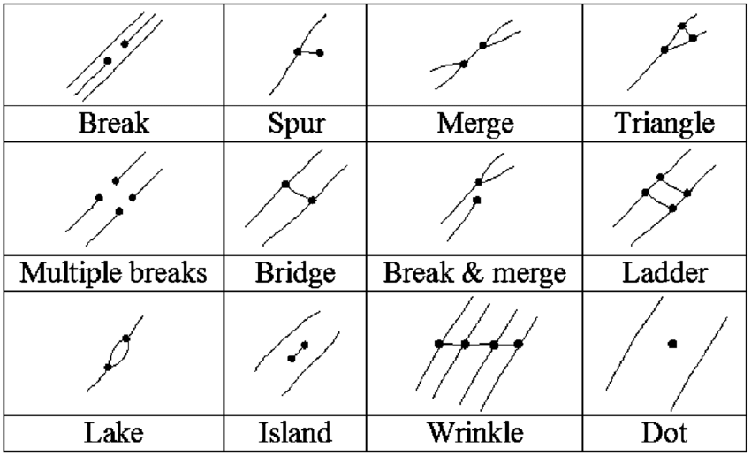
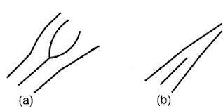
Examples of false minutiae
REAL MINUTIAE:
(a) Ridge bifurcation
(b) Ridge ending

Slide 13
Procedures to Remove false minutiae
If the distance between one bifurcation and one termination is less than D and the two minutiae are in the same ridge (spur), remove both of them. D is the average inter-ridge width representing the average distance between two parallel neighboring ridges
If the distance between two bifurcations is less than D and they are in the same ridge, remove the two bifurcations (multiple breaks, lake, triangle and ladder cases)
If two terminations are within a distance D and their directions are coincident with a small angle variation and they suffice the condition that no any other termination is located between the two terminations, then the two terminations are regarded as false minutia derived from a broken ridge and are removed (break, island and dot case)
If two terminations are located in a short ridge with length less than D, remove the two terminations
If a branch point has at least two neighboring branch points, which are each no further away than maximum distance threshold value and these branch points are closely connected on common line segment the remove the branch points (wrinkle)

Slide 14
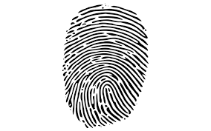
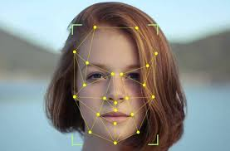
Multimodal Biometric Fusion
Minutiae
Match
Matching
Score
Simple
Product
Of
Fusion
Final
Decision
Uniform
LBP
Matching
Score

Slide 15



Matching Score Fusion
Simple product Rule :
K-NN Classifier : a special case of K-NN classifier for K=1 is employed where a sample is assigned to its closest neighbor shows superior performance
=

Slide 16
K-NN Classifier
For each human image in the test set, we calculate distance between extracted features for each input trait and features of the claimed identity in the training database.
Find minimum distances of feature vectors for face and fingerprint separately.
We choose the score of the nearest fused distances for face and fingerprint in the training database using nearest neighbour classifier for final decision.
Since test session has two biometrics, fusion at matching scores at biometric is performed. For distances we use normalize the distance using product rule

Slide 17
Face Recognition using Local Binary Pattern

Slide 18
Previous Work
In the previous presentation, I have discussed about
Use of the face recognition.
The History of face recognition.
The technique to implement face recognition.
General Methodology to implement the technique.
The various challenges of these technique.

Slide 19

Method of LBP
In the LBP method, we will use the uniform local binary method. A local binary pattern is called uniform if the binary pattern contains at most two 0-1 or 1-0 transitions. For example, patterns 00111000, 11111111, 00000000, and 11011111 are uniform, and patterns 01010000, 01001110, or 10101100 are not uniform. Selecting only uniform patterns contributes to both reducing the length of the feature vector (LBP histogram) and improving the performance of classifiers using the LBP features.

Slide 20
The LBP method can be implemented in the following ways
At first, facial image is divided into small region.
A texture description for the sub-image is then calculated using the local binary pattern.
The texture description is then combined into a histogram.
At last, the histogram encodes the appearance and the spatial relations of facial regions.

Slide 21
To describe the local spatial structure of an image the local binary operator is used, which is defined as a non-parametric operator. To extract the LBP texture descriptor of a region, the operation begins by assuming a level to each pixel of a region by thresholding the neighbourhood of a pixel with the value of centre pixel resulting the binary representation. Each bit combinations then identifies a particular level, and the corresponding level histogram is used as a texture descriptor.

Slide 22
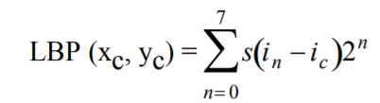

The local binary method is implemented using the following formula
Where, i_{c} corresponds to the value of the centre pixel, i_{n} denotes the value of the eight surrounding pixels, s(x) is defined as

Slide 23
So, the general method to find the LBP codes is
In a 3x3 matrix, the centre pixel is compared with its eight neighbours.
The local representation noted with 0 if the value of the centre pixel is greater than the neighbour and 1 if the value of the centre pixel is equal or smaller than the neighbour.
The result of this comparison stored by its order into several digits and became a binary number.
The binary numbers are referred to as LBP codes and they describe the local texture pattern of the image.
Generally, the LBP method works in gray-scale image. So, we need to transfer all the images to gray-scale images first.

Slide 24
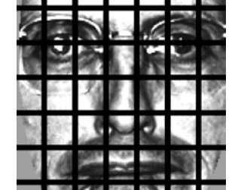
In this figure, we have a face in a dataset, the first step of the algorithm is to divide the face into 7×7 equally sized cells. In the LBP method, we have to divide a face dataset into several equal sized cells and then for each of these cells, we compute a Local Binary Pattern histogram.

Slide 25

Definition of Histogram
By definition, a histogram throws away all spatial information regarding how the patterns are oriented next to each other. However, by computing a histogram for each of the cells, we actually are able to encode a level of spatial information such as the eyes, nose, mouth, etc., that we would otherwise not have.

Slide 26
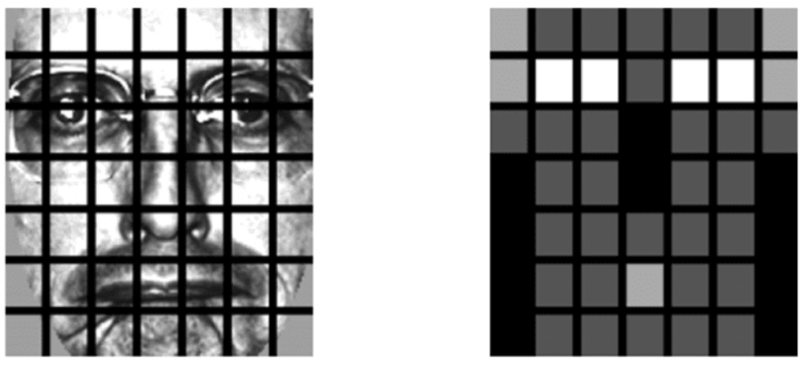
This spatial encoding also allows us to weigh the resulting histograms from each of the cells differently, giving more discriminative power to more distinguishing features of the face. Here, we take weighting scheme for each of the cells.

Slide 27
The weighting scheme which is used is experimentally found by Ahonen et al. by running hyperparameter tuning algorithms on top of their training, validation, and testing data splits.
LBP histograms for the white cells (such as the eyes) are weighed 4x more than the other cells. This simply means that we take the LBP histograms from the white cell regions and multiply them by 4 (taking into account any scaling/normalization of the histograms).
Light Gray cells (mouth and ears) contribute 2x more.
Dark Gray cells (inner cheek and forehead) only contribute 1x.
Finally, the black cells, such as the nose and outer cheek, are totally disregarded and weighed 0x.

Slide 28
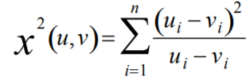
Finally, the weighted 7×7 LBP histograms are concatenated together to form the final feature vector.
Performing face recognition is done using the distance and the nearest neighbour classifier.
The chi-squared distance is defined as
Where, u and v are the normalised histograms, and n is the number of elements in the histogram. The chi-squared is known as the effective measurement of similarity between the pair of histograms.

Slide 29
Example of implementation of the method
9 | 5 | 7
4 | 10 | 1
12 | 45 | 2
0 | 0 | 0
0 |  | 0
1 | 1 | 0
From this, we can find that the binary representation of the centre pixel is defined as 0x2⁰+0x2¹+0x2²+0x2³+0x2⁴+1x2⁵+1x2⁶+0x2⁷=96

Slide 30

Steps
A face is presented to the system
LBPs are extracted, weighted, and concatenated in the same manner as the training data
k-NN (with k=1) is performed with the distance to find the closest face in the training data.
The name of the person associated with the face with the smallest chi-squared distance is chosen as the final classification.

Slide 31
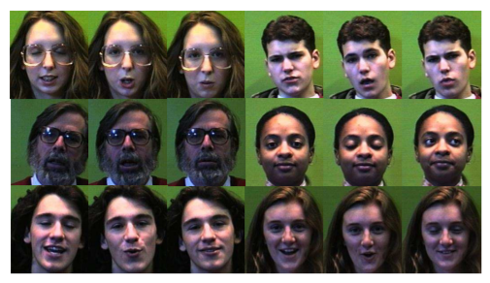
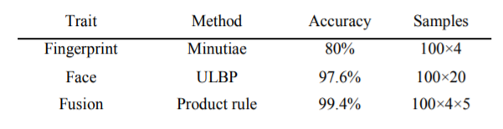
Experimental Result

Slide 32
Problem in Biometric Recognition
Light in face
Position of face
Presence of scars and cuts

Slide 33
Score Level Fusion
Score Normalization
Generation of Similarity Scores
Fusion

Slide 34

Score Normalisation
This step brings both matching scores between 0 and 1. The normalization of both scores are done by the following formula:
Where, min_{face} and max_{face} are the minimum and maximum scores for face recognition and min_{finger} and max_{finger} are the corresponding values obtained from fingerprint.

Slide 35
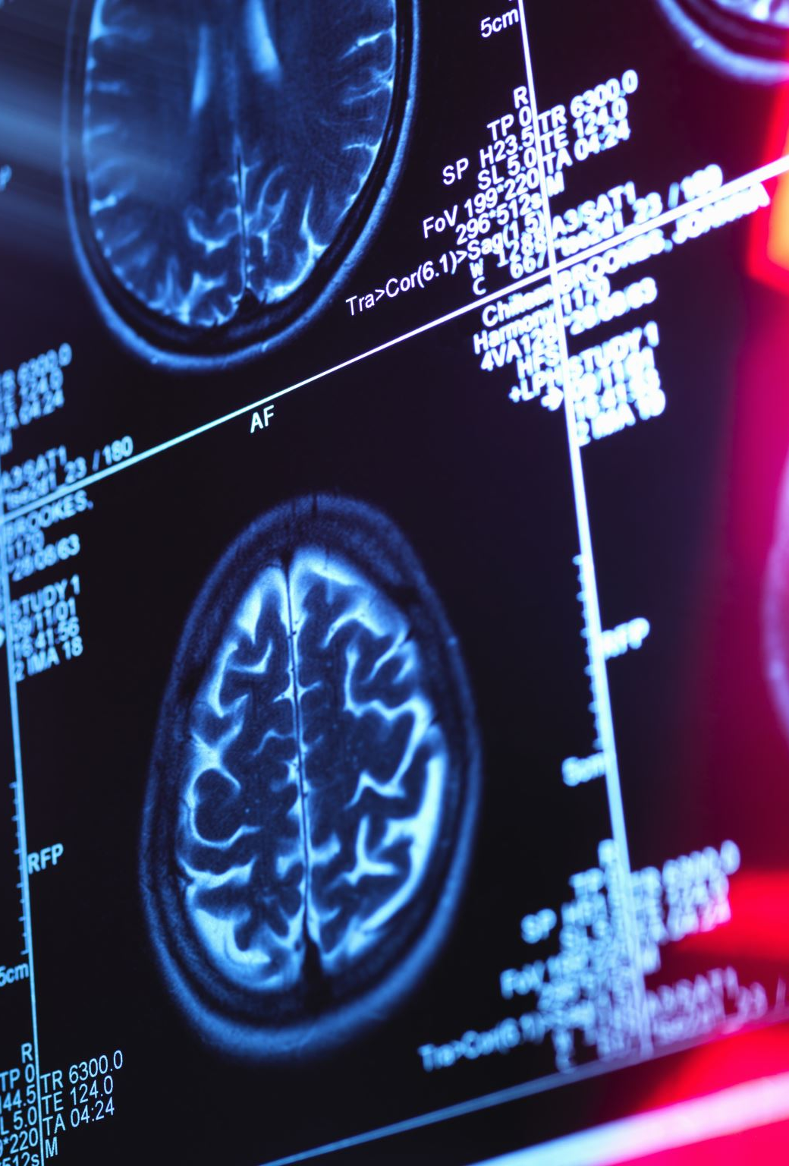
Generation of Similarity Scores
The normalized score of the face which is obtained through LBP while the normalized score from fingerprint gives a similarity measure. So, to fuse both the score, there is a need to make both the scores either similarity or dissimilarity measure.

Slide 36

Fusion
The two normalized similarity scores N and N are fused linearly using sum rule as
α and β are three weight values that can be determined using some function. Here, a combination of linear and exponential functions are used. The value of weight is assigned linearly if the value of the matching score is less than the threshold; otherwise, exponential weightage is given to the score. The value of MS is used as the matching score. So, if MS is found to be more than the given threshold value is accepted otherwise it is rejected.

Slide 37
Challenges of multimodal recognition
Privacy and Data Breach
Errors in Recognition

Slide 38

Thank You

